Slide 1


Slide 2
Chapter 17
Introduction to Transaction Processing Concepts and Theory

Slide 3
A transaction is a sequence of read and write operations on data items that logically functions as one unit of work
It should either be done entirely or not at all
• If it succeeds, the effects of write operations persist (commit); if it fails, no effects of write operations persist (abort)
• These guarantees are made despite concurrent activity in the system, and despite failures that may occur
Slide 17-<number>

Slide 4
ACID Properties of Transaction
• Atomic
Process all of a transaction or none of it; transaction cannot be further subdivided (like an atom)
• Consistent
Data on all systems reflects the same state
• Isolated
Transactions do not interact/interfere with one another; transactions act as if they are independent
• Durable
Effects of a completed transaction are persistent
Slide 17-<number>

Slide 5
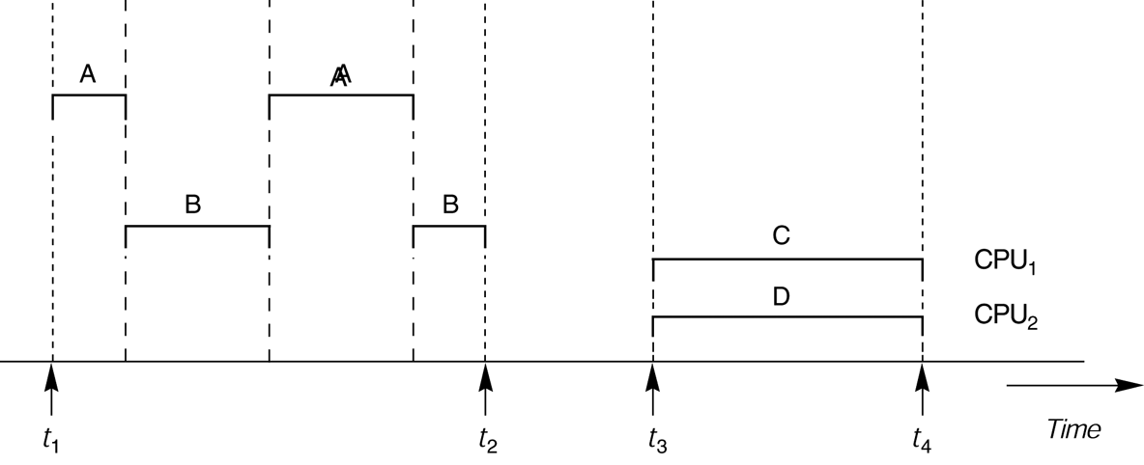
FIGURE 17.1
Interleaved processing versus parallel processing of concurrent transactions.
Slide 17-<number>

Slide 6

FIGURE 17.2
Two sample transactions. (a) Transaction T₁. (b) Transaction T₂.
Slide 17-<number>

Slide 7
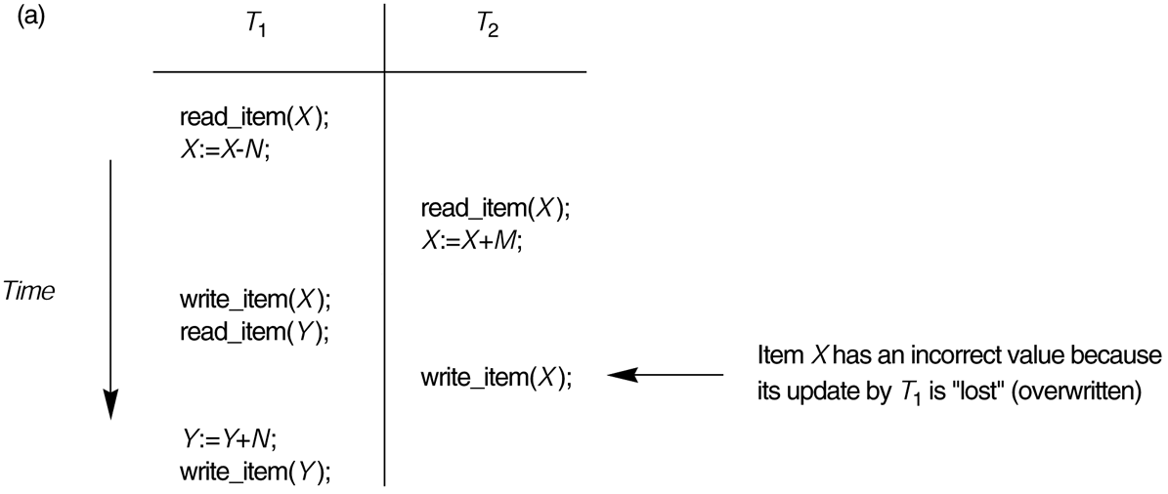
FIGURE 17.3
Some problems that occur when concurrent execution is uncontrolled. (a) The lost update problem.
Slide 17-<number>

Slide 8
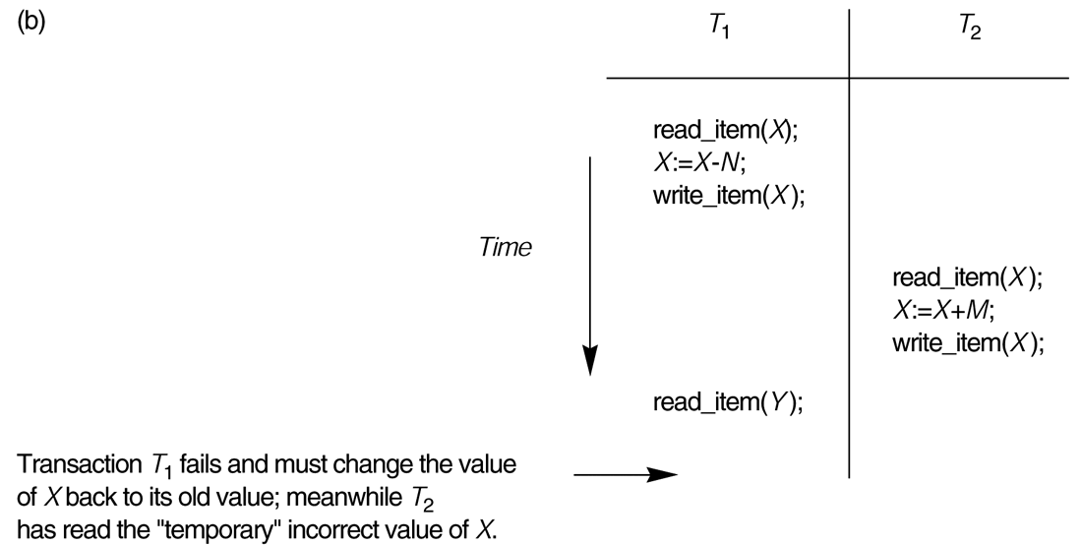
FIGURE 17.3 (continued)
Some problems that occur when concurrent execution is uncontrolled. (b) The temporary update problem.
Slide 17-<number>

Slide 9
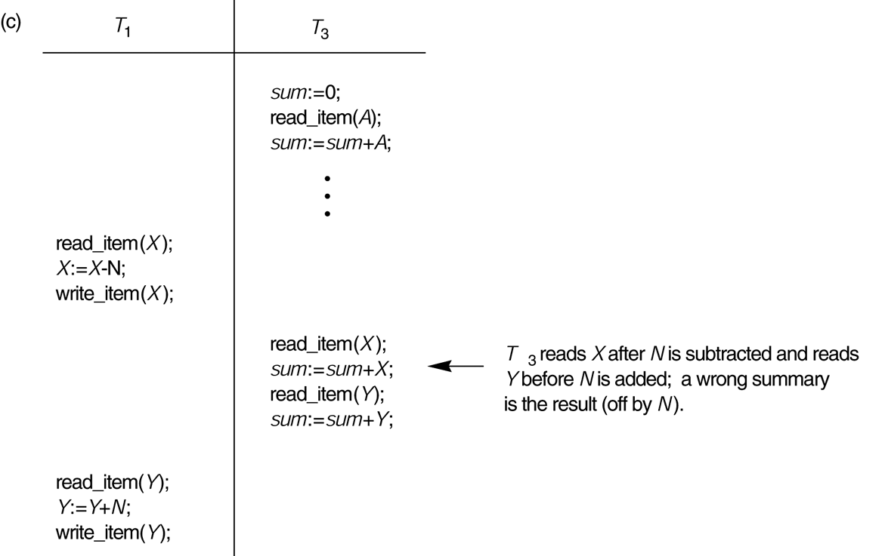
FIGURE 17.3 (continued)
Some problems that occur when concurrent execution is uncontrolled. (c) The incorrect summary problem.
Slide 17-<number>

Slide 10
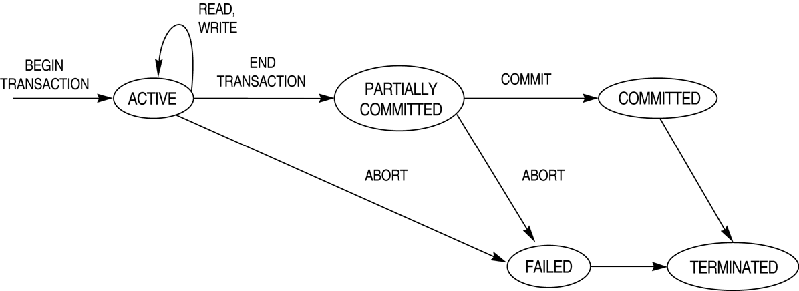
FIGURE 17.4
State transition diagram illustrating the states for transaction execution.
Slide 17-<number>

Slide 11
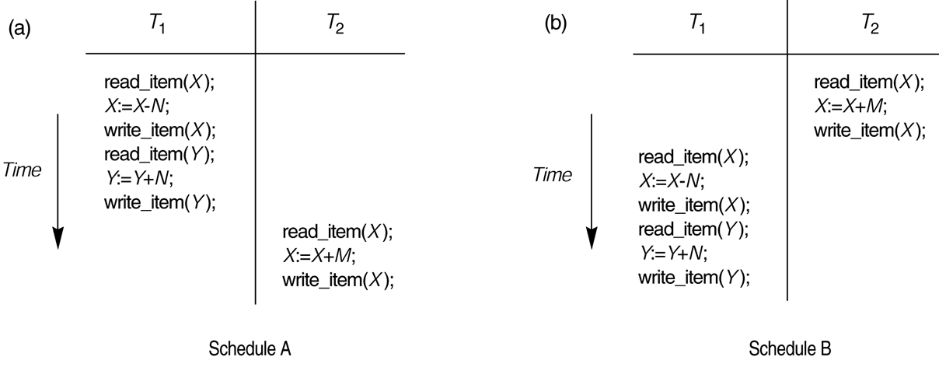
FIGURE 17.5
Examples of serial and nonserial schedules involving transactions T₁ and T₂. (a) Serial schedule A: T₁ followed by T₂. (b) Serial schedules B: T₂ followed by T₁.
Slide 17-<number>

Slide 12
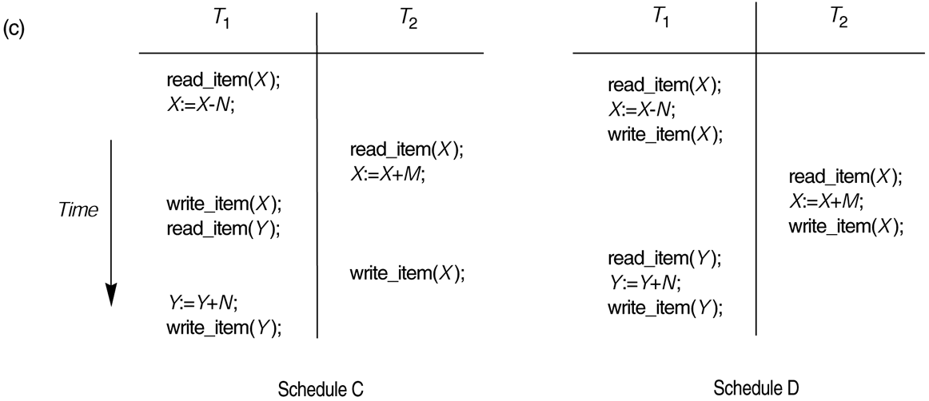
FIGURE 17.5 (continued)
Examples of serial and nonserial schedules involving transactions T₁ and T₂. (c) Two nonserial schedules C and D with interleaving of operations.
Slide 17-<number>

Slide 13
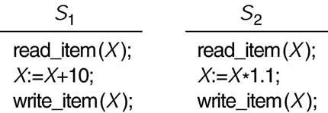
FIGURE 17.6
Two schedules that are result equivalent for the initial value of X = 100 but are not result equivalent in general.
Slide 17-<number>

Slide 14
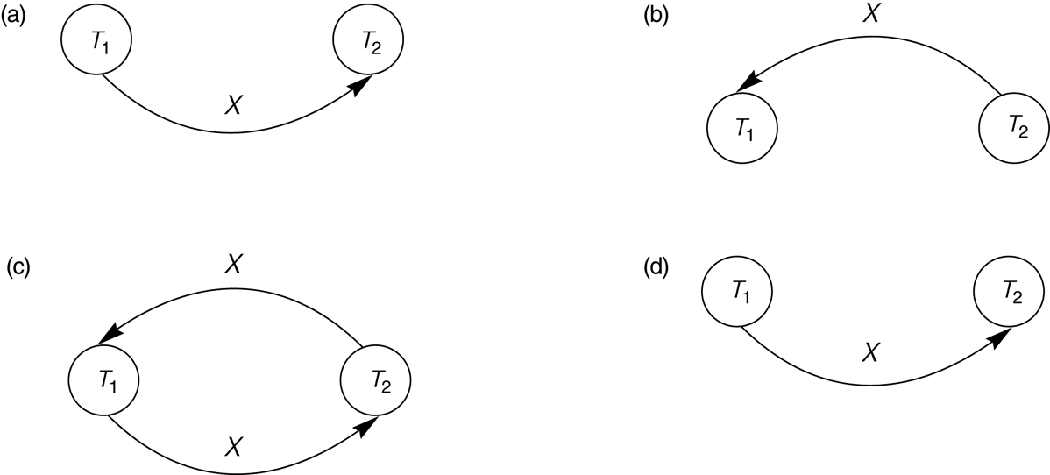
FIGURE 17.7
Constructing the precedence graphs for schedules A and D from Figure 17.5 to test for conflict serializability. (a) Precedence graph for serial schedule A. (b) Precedence graph for serial schedule B. (c) Precedence graph for schedule C (not serializable). (d) Precedence graph for schedule D (serializable, equivalent to schedule A).
Slide 17-<number>

Slide 15
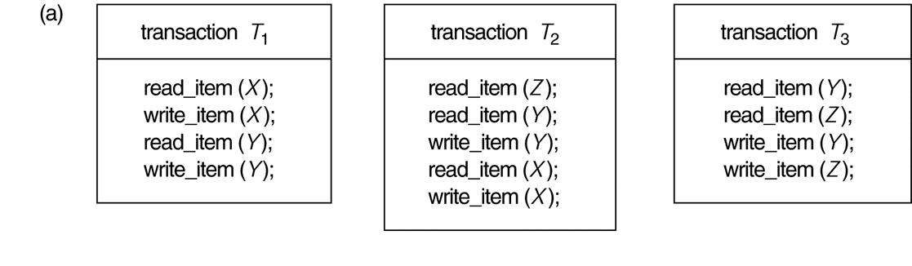
FIGURE 17.8
Another example of serializability testing. (a) The READ and WRITE operations of three transactions T₁, T₂, and T₃.
Slide 17-<number>

Slide 16
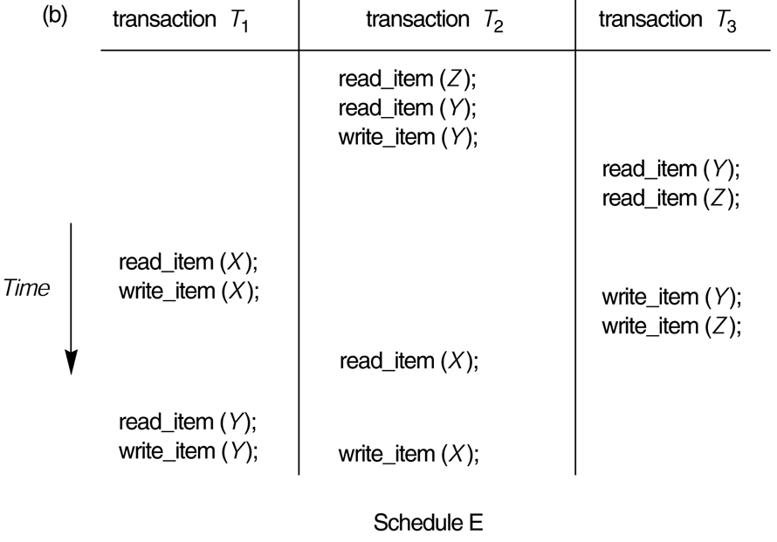
FIGURE 17.8 (continued)
Another example of serializability testing. (b) Schedule E.
Slide 17-<number>

Slide 17
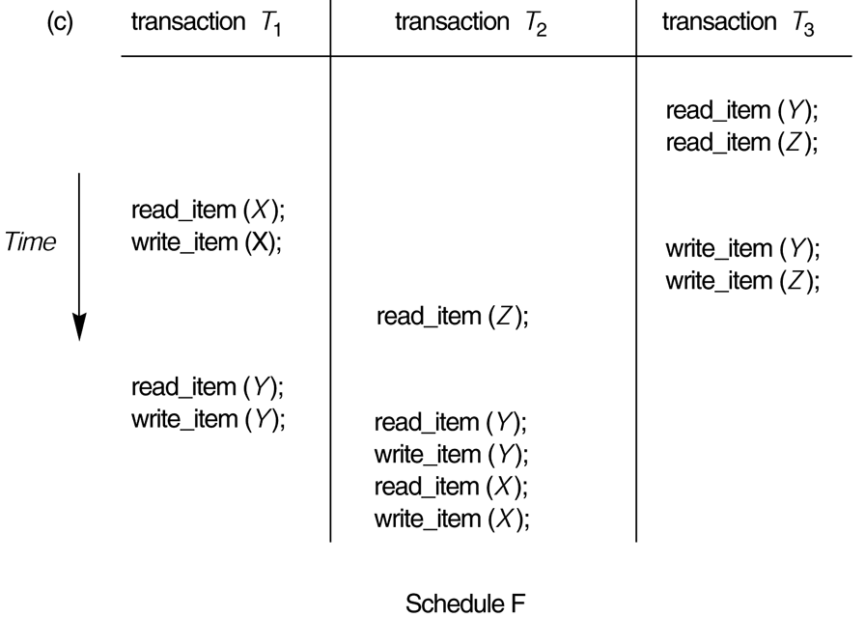
FIGURE 17.8 (continued)
Another example of serializability testing. (c) Schedule F.
Slide 17-<number>

Slide 18
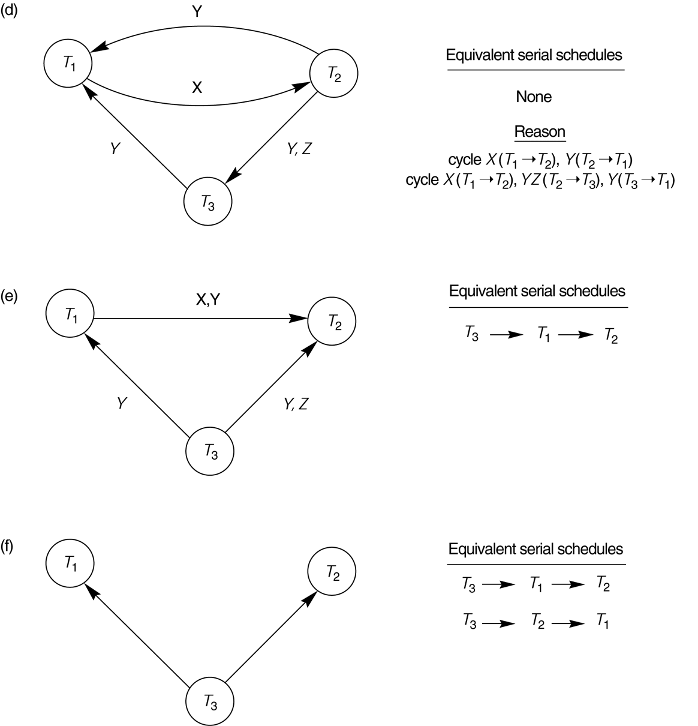
FIGURE 17.8 (continued)
Another example of serializability testing.
(d) Precedence graph for schedule E.
(e) Precedence graph for schedule F.
(f) Precedence graph with two equivalent serial schedules.
Slide 17-<number>

